Slide 1
Welcome to Year 1 and 2
Thursday 19th September 2024

Slide 2
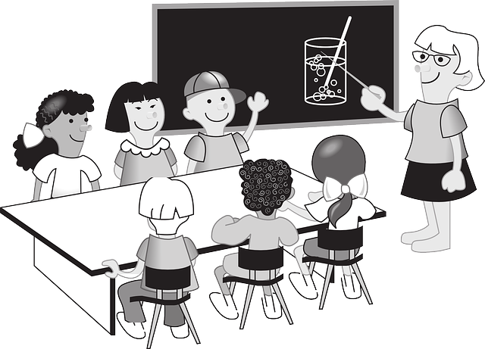
The Team: Teachers
Year 1 – Mrs Clist (Tigers)
Mrs Foster (Jaguars)
Year 2 – Miss Stevens (Otters)
Miss Garcia-Perez (Moles)

Slide 3

The Team: Teaching Assistants
Year 1 – Miss Nurse
Mrs Lovelock
Year 2 – Mrs Clulow
Mrs Bentley
Miss Harmsworth

Slide 4

A Typical Day
Year 1
8:45 | 9:10 | 10:00 | 10:15 | 10:30 | 11:00 | 12:10 | 1:00 | 1:30 | 3:00
Register | English | Mastering number | Break | Phonics | Maths | Lunch | Reading | Foundation subjects | Story time
Autumn term transition from EYFS
Year 2
8.45 | 9.10 | 10.15 | 10.30 | 10:50 | 12:10 | 1:00 | 1:30 | 2:00 | 3:00
Register | English | Break | Mastering number | Maths | Lunch | Phonics | Reading | Foundation subjects | Story time

Slide 5

Foundation Subject Units
Year One | Autumn | Spring | Summer
Science | Seasons Weather Human body | Animals Plants Seasons | Materials Seasons
History | Toys |  | Local area
Geography | Weather Seasons | United Kingdom | Local area
Art / DT | Cooking Sewing Painting | Where food comes from Sculpture | Designing Drawing
Computing | Technology around us Digital Painting | Moving a robot Grouping data | Digital writing Animation

Slide 6

Foundation Subject Units
Year Two | Autumn | Spring | Summer
Science | Animals Living things Habitats | Materials | Animals Humans Plants
History | Carnival |  | Great Fire of London
Geography | Continents Oceans | Hot and cold places | Contrasting locality - Africa
Art / DT | Winding mechanisms Drawing | Painting Printing Puppets | Drawing Cooking Collage
Computing | Technology around us Digital Photography | Robot Algorithms Pictograms | Making Music Creating Quizzes

Slide 7

English
Year One | Year Two
Capital Letters and Full Stops | Capital Letters and Full Stops
Finger Spaces | Finger Spaces
Simple adjectives | Adjectives
Handwriting – letter formation | Verbs and Adverbs
Spellings & phonics application to simple sentences | Conjunctions
Whole class reading session | Cursive Handwriting
 | Spellings & Phonics application to complex sentences
 | Whole Class reading session
Every Child reads 1:1 to an adult | Every Child reads 1:1 to an adult daily
Information about what we learn and the texts used within English can be found on the school Website

Slide 8
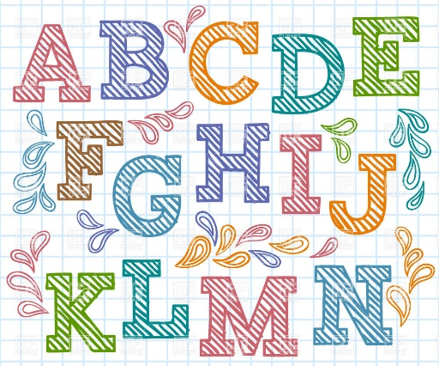
Phonics
Between 20 mins and half an hour a day
Children streamed across each Year Group – taught at an appropriate level while still providing challenge.
Groups flexible and changes made where necessary
Through an intervention called Toe by Toe, some children receive a more structured approach in addition to Phonics. This ensures they retain their core learning.

Slide 9

Maths
Mastering number
  Short daily session focusing on number fluency and fact families
Autumn Term Core Learning
Year One | Year Two
Place Value to 10 | Place Value – Numbers to 100
Addition and Subtraction to 10 | Addition and Subtraction to 100
2D and 3D Shapes | Shape – vocabulary of properties
 | Symmetry
Spring / Summer term learning can be found on Year 1 and 2 class pages on website.

Slide 10
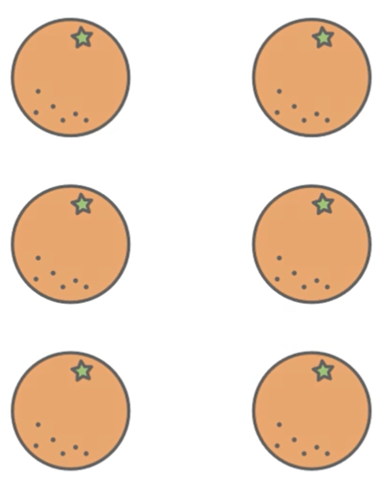




Maths
Subitising
“being able to visually see a number of objects instantly without needing to count them out one at a time”

Slide 11
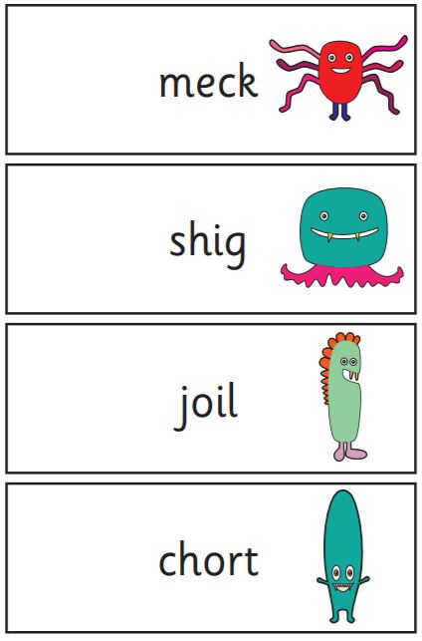
PHONICS CHECK in Y1 and SATS in Y2
Year 1 Phonics
Summer Term (June) All children 40 word test
20 real, 20 nonsense – Children call these alien words
Children well prepared for format before completing with
Mrs Clist
Year 2 SATS
Summer Term (May)
Reading & Maths
All children well prepared for format
Follow up phonic assessment if required

Slide 12

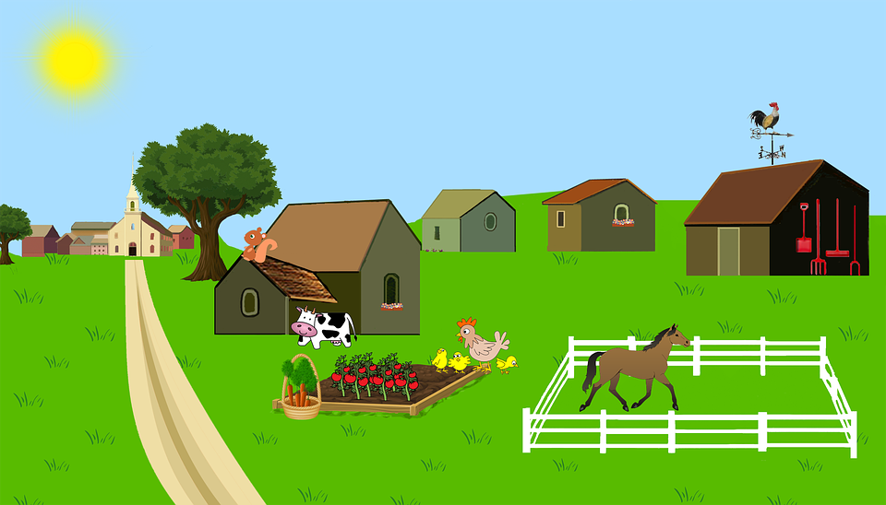
Visits
Year One
Puxton Park – Spring Term
Local Walks – Summer Term
Year Two
Noah’s Ark – Autumn Term (October)

Slide 13

PE/ Sport
Kit - PE kit is red t-shirt and black shorts in warmer weather with daps or trainers. Warm joggers and a sweatshirt (hoody) and trainers for the Winter.
Year 1 – Tuesday 10.30am-12pm (flexible pm)
Year 2 – Thursday 10.30am-12pm (flexible pm)
Enrichment Fridays – Some children will need kits on a Friday if taking part in Gymnastics or Sport. We will update each term if this is required for your child.

Slide 14

Enrichment – Alternate Fridays
Variety of activities
Gymnastics
Musical instruments
Singing
Arts and crafts
Drama
Sport

Slide 15

Home Learning
TT Rockstars – Year 2 onwards from October Half Term
Reading – 3 times a week earns a house point
Please continue to record in reading records & return to school on Fridays.
Spellings – Tested on a Monday, home on a Wednesday
Introduced in class before sending home
Interactive games on Emile if you wish to use them

Slide 16
Reminders
Please remember coats every day, we try really hard to get out in all weathers.
As they did in Early Years, all children in Year 1 and Year 2 have free fruit under the government scheme.
Children may of course bring in their own healthy snacks.
All children fall in and out of friendships, and accidents and any changes in routine can easily affect their confidence and self-esteem. If you feel something is worrying your child please talk to us as soon as possible so that we can help.
If you have any questions, worries or issues and you feel it is too busy on the door, please e-mail or ask for a quick phone call later in the day. We are here to help!
Check the school website under your child's class page for any of the learning information you need, search for Brookside Academy.

