Slide 1
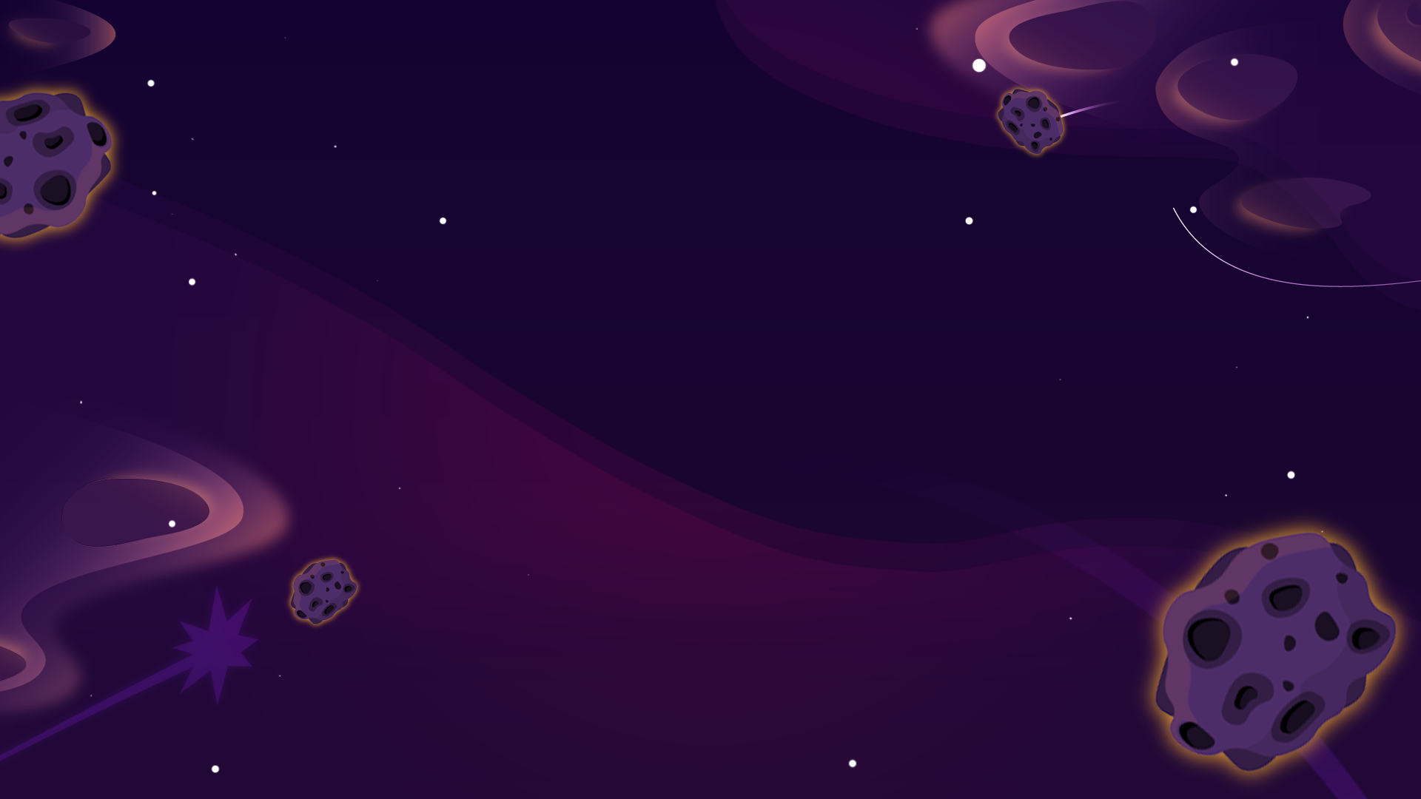

Slide 2
Meet Emile, Aimee and Scrambler.

Slide 3
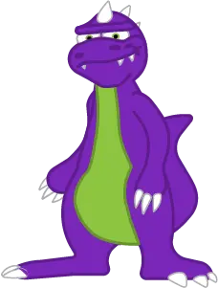
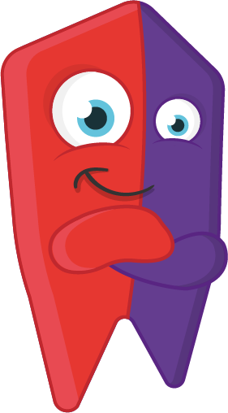
One day, a dinosaur called Scrambler, who lives on the planet Primus, was searching
for food. Without much knowledge of the world, he found a magic gem that helped him learn. Before he knew it, he wanted more and more Knowledge Gems.
He searched and searched, until he realised that to gain more Knowledge Gems,
he would have to visit different planet. And steal them!
Scrambler’s quest inevitably brought him to Emile’s planet of Mathedonia. He executed a simple heist as had done countless times before netting another huge haul of Knowledge Gems.
However, an ordinary young shape shifting alien called Emile spotted the heist. With the help of his best friend Aimee (the Artificial Intelligence Maths Engine), they had the courage to chase after Scrambler to save his people and get back their Knowledge Gems.
It was from then on Emile and Aimee decided it was their duty to help protect other planets throughout
the galaxy from Scrambler and his quest for stealing knowledge.

Slide 4
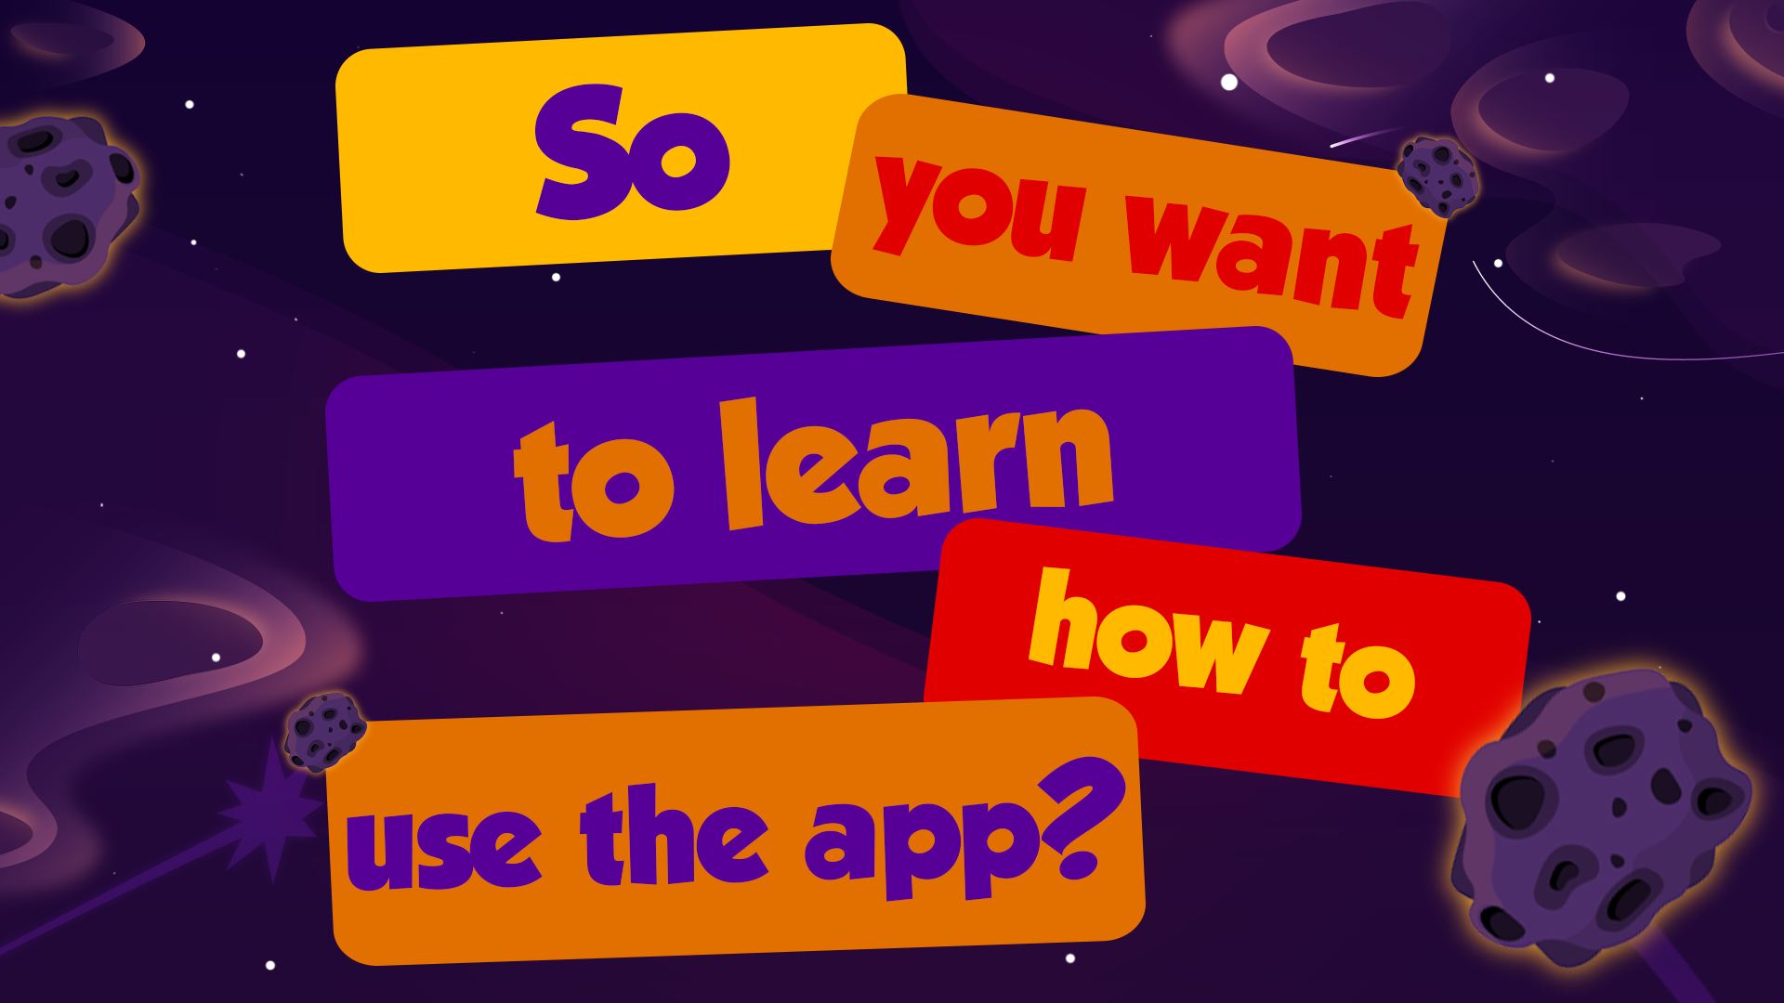
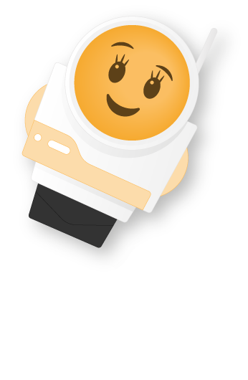
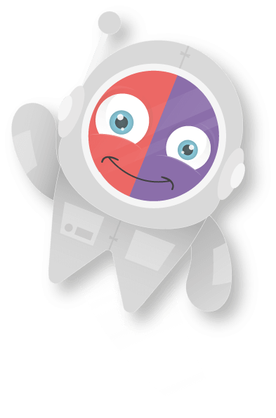
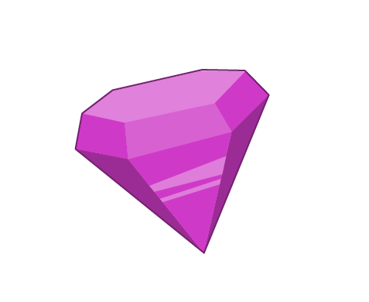

Slide 5
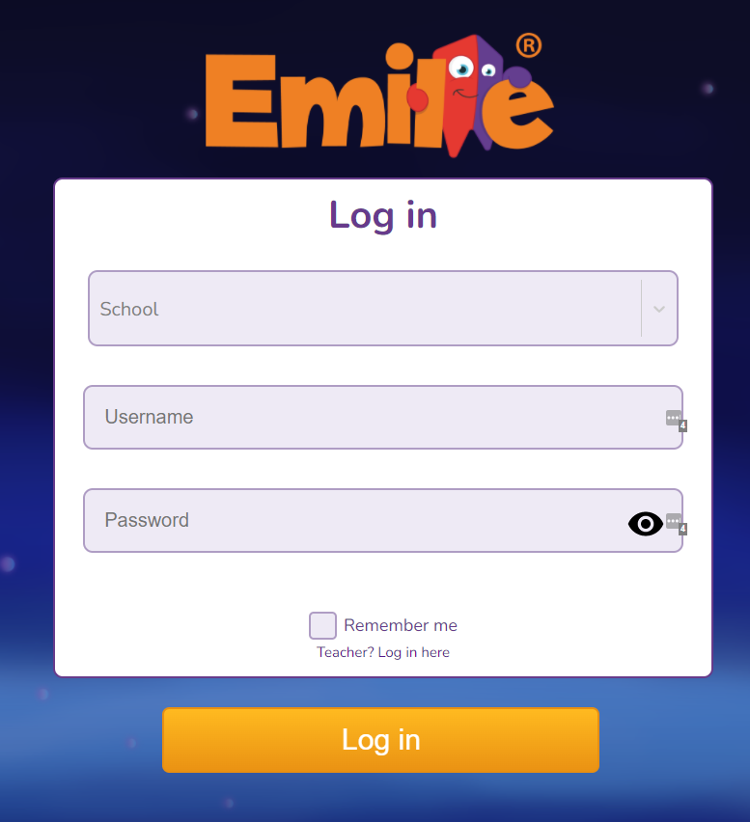
Let’s start!
Your teacher will give you your
log in details.
You will then use those details to
log into Emile’s app!
The app works on Windows, Chromebook, Android Tablets & Phones and iPhones & iPads.

Slide 6
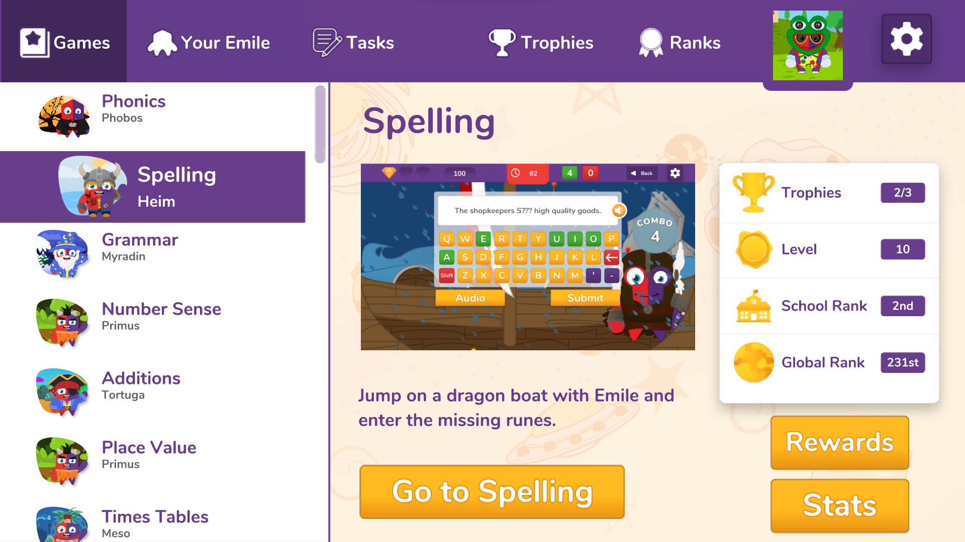
Your Dashboard
Your dashboard will look a bit like
this, depending on what games your
school has access.

Slide 7
On your dashboard you can…
Play fun games
Visit Your Emile
See Your Trophies
Assignments
School and class challenges

Slide 8
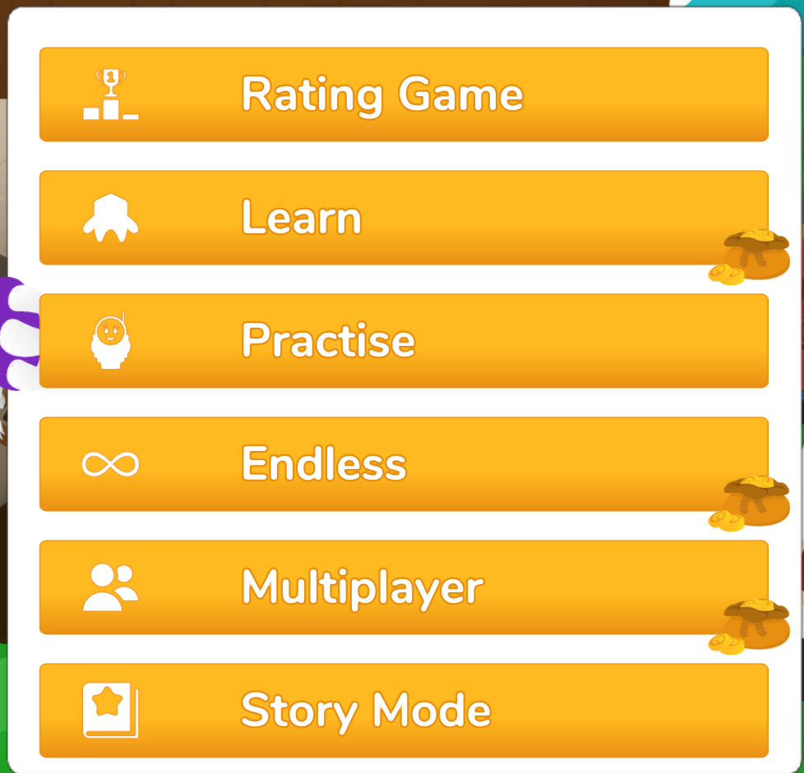
Types of games
There are various modes you can play! Whether you want to compete or play solo, it’s up to you!

Slide 9
Rating Game
You must complete a Rating Game before being able to access any other game mode. This helps make sure you get the right questions for you!
Practise Mode
This mode is for you to practise answering questions so you can get better and faster.
Endless Mode
How many levels can you climb up with only 3 lives? Find out by testing your skills!
Story Mode
Follow Emile, Aimee and Scrambler on each planet and help them unravel an enchanting story .
Multiplayer Mode
Are you ready to test your knowledge? Play against classmates or pupils from around the world.

Slide 10
Rating Mode
You must complete a Rating Game before being able to access any other game mode. This helps make sure you get the right questions!

Slide 11
Practise Mode
This mode is for you to practise answering questions so you can get better and faster.

Slide 12
Endless Mode
How many levels can you climb up with only 3 lives? Find out by testing your skills!

Slide 13
Multi-Player Mode
Are you ready to test your knowledge? Play against classmates or pupils from around the world.

Slide 14
Story Mode
Follow Emile, Aimee and Scrambler on each planet and help them unravel an enchanting story

Slide 15
Learn Mode
A new mode specifically for Spelling!

Slide 16
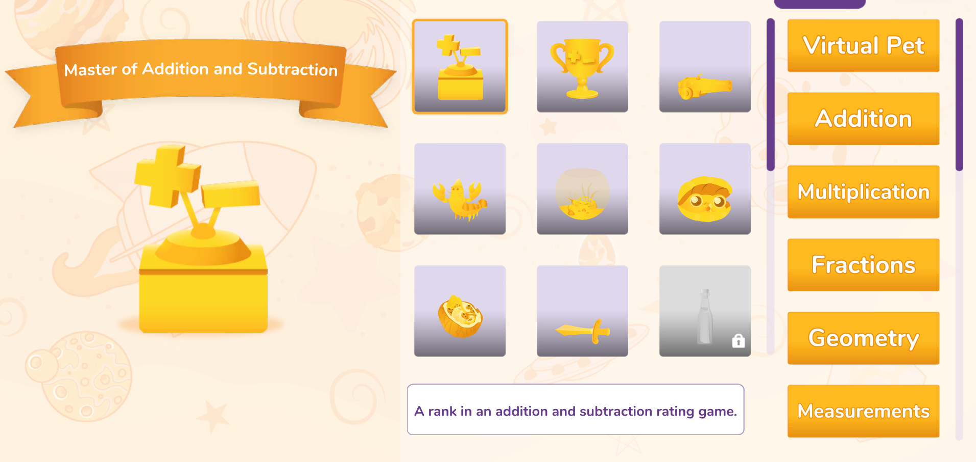
Your Trophies
Because you’re a champion!
Here you can find all the trophies you have won.

Slide 17
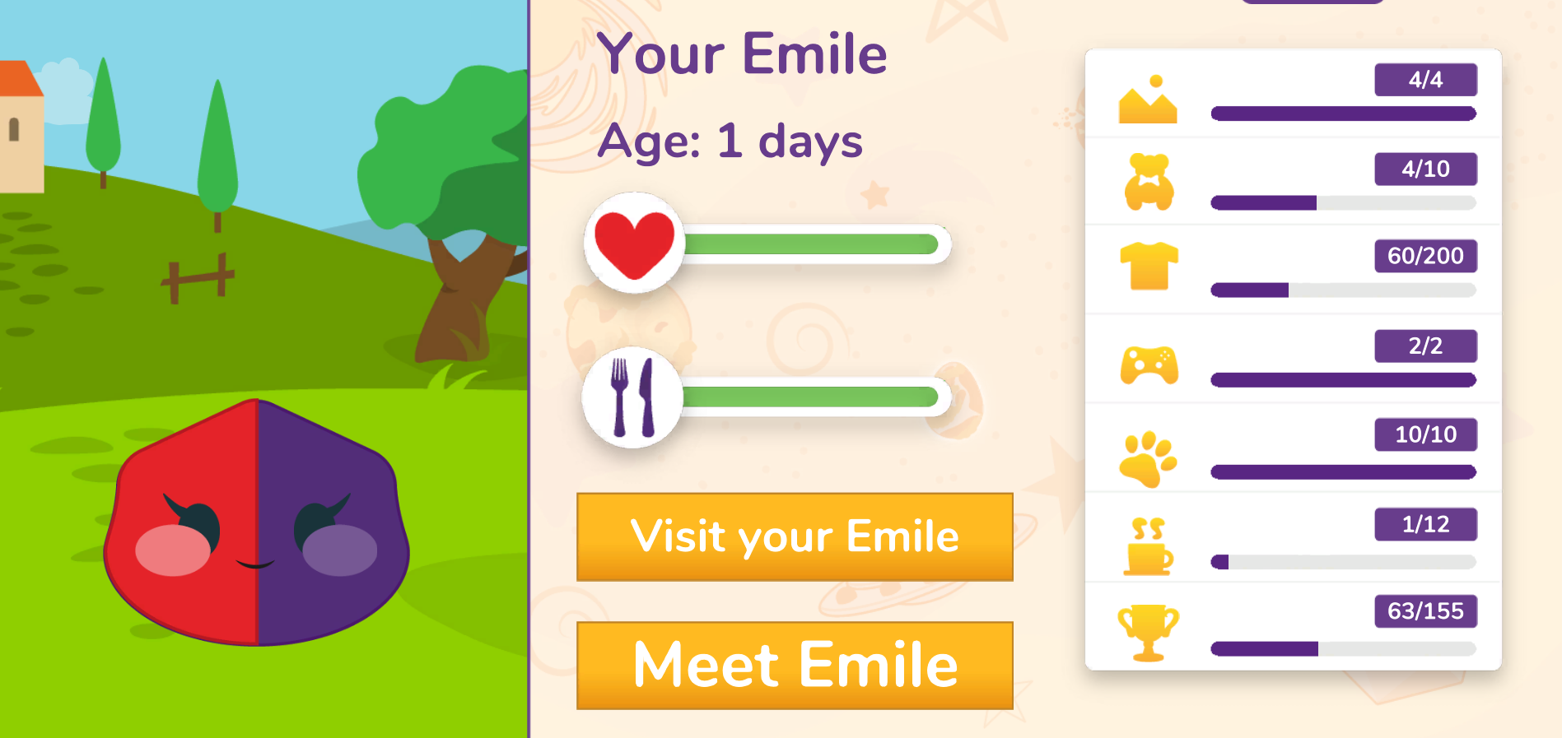
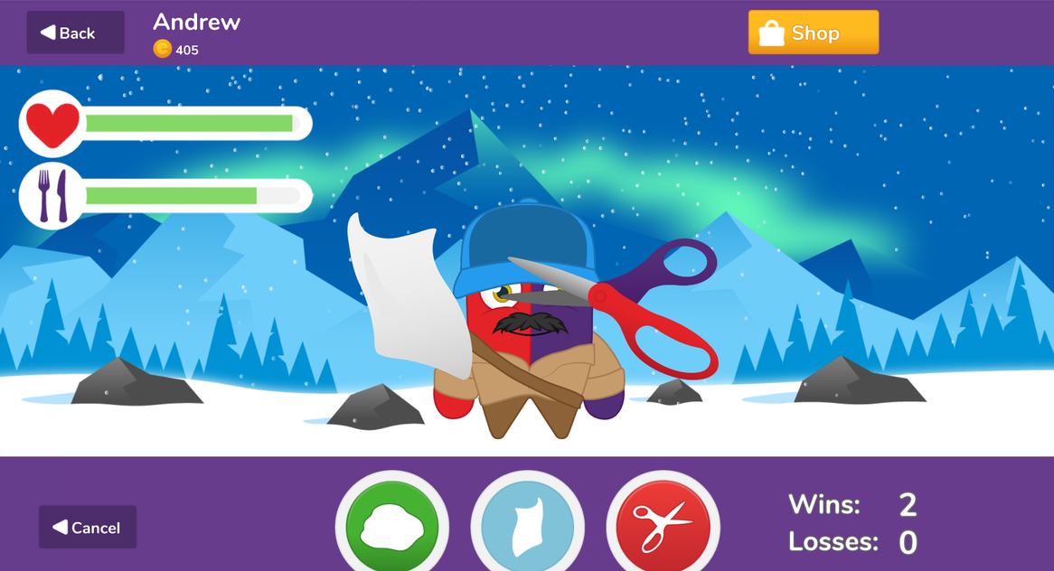
Your Emile
Your Emile can be found on your top menu. Here you can play minigames and dress up your character with the coins you earn from playing games.
Your Emile will start as a baby and grow into a toddler, teenager and the adult.
Once an adult you can buy all sorts of clothes, toys and games!

