Slide 1
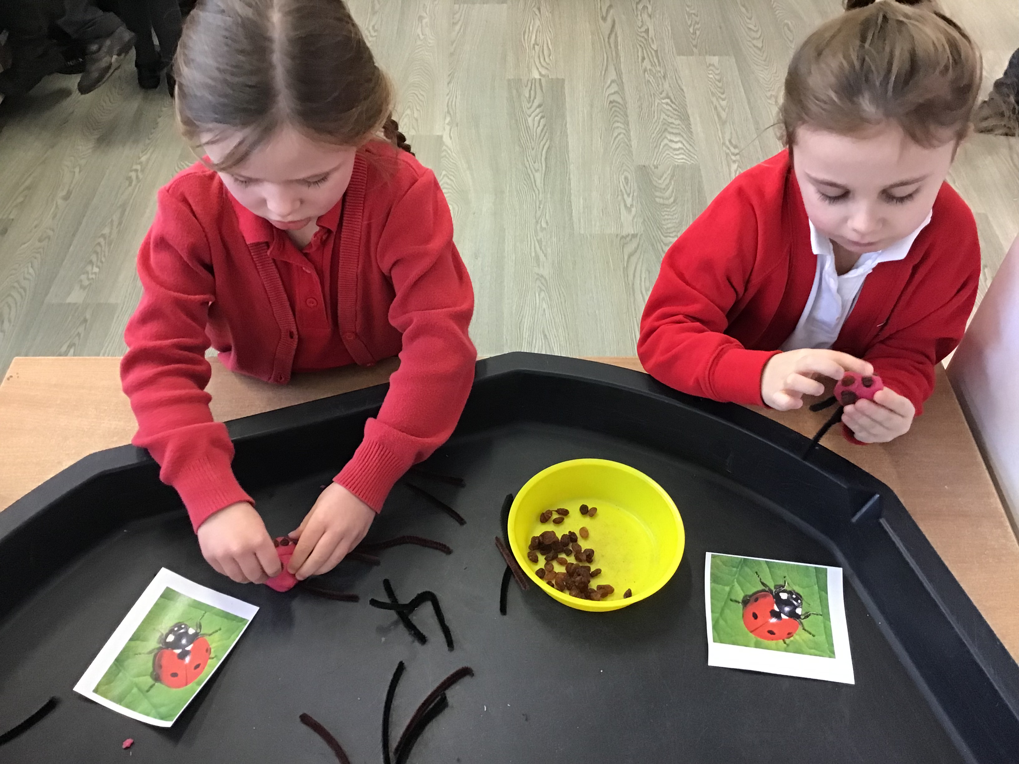
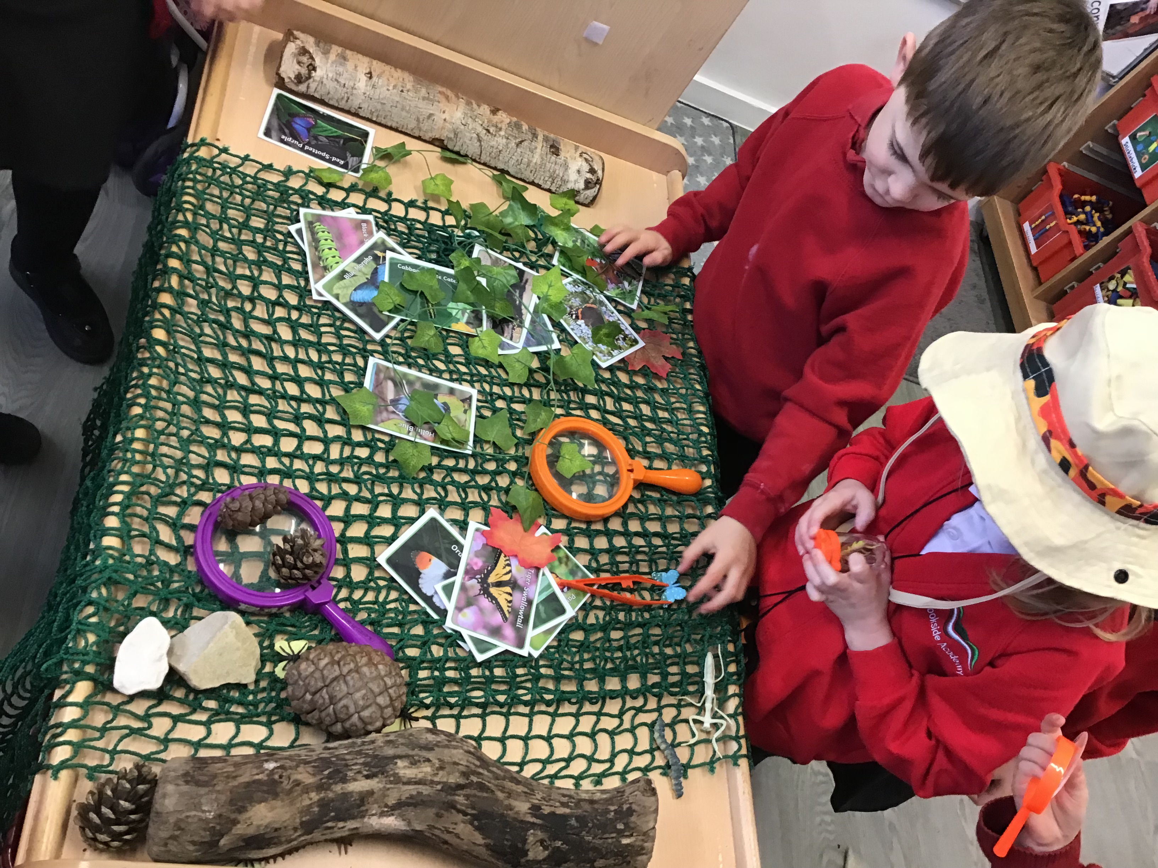
Early Years
Brookside Academy

Slide 2
Reading
Communication and language – Stories, songs, poetry, pictures for talking
Encouraging new vocabulary, sentence building, early comprehension skills and answering questions, prediction and creation of story maps.
Phonics – We use Twinkl Phonics scheme, starting at Phase 2 with single phonemes and the corresponding grapheme.
Moving into Phase 3 and introducing digraphs and trigraphs.
Blending and segmenting are a key feature of our Phonics learning.
We learning 4 new sounds across two weeks. Week 1 – learning new sounds with teacher and then Week 2 – consolidating learning of all previous sounds with Teaching Assistants.

Slide 4
Phase 4

Slide 5
Phonics Jargon Buster There is a handout available for you to take home.

Slide 6
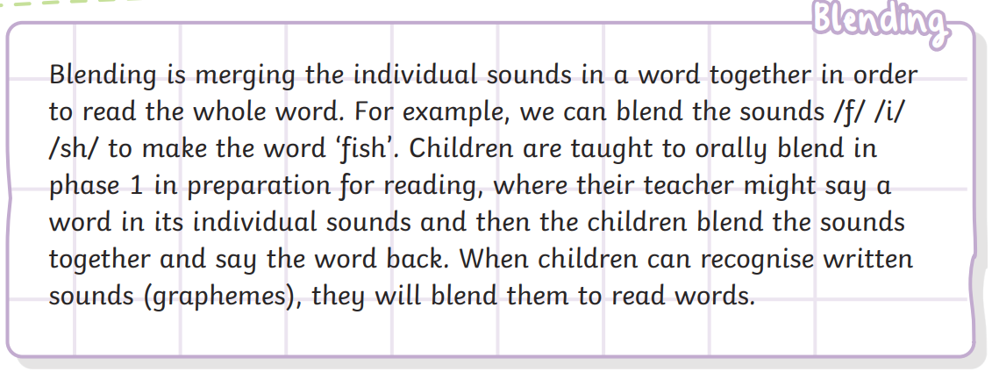
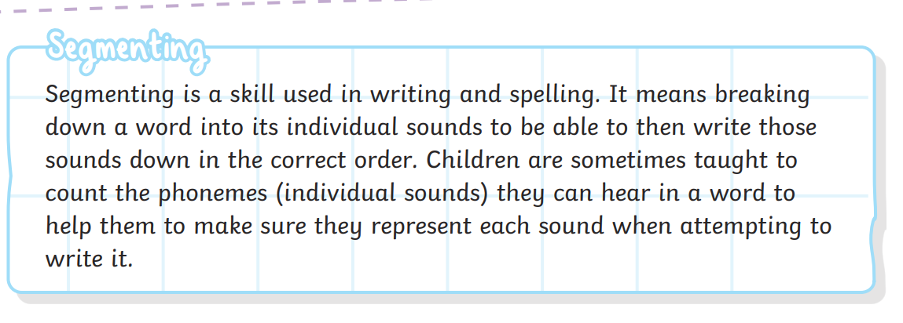

Slide 7
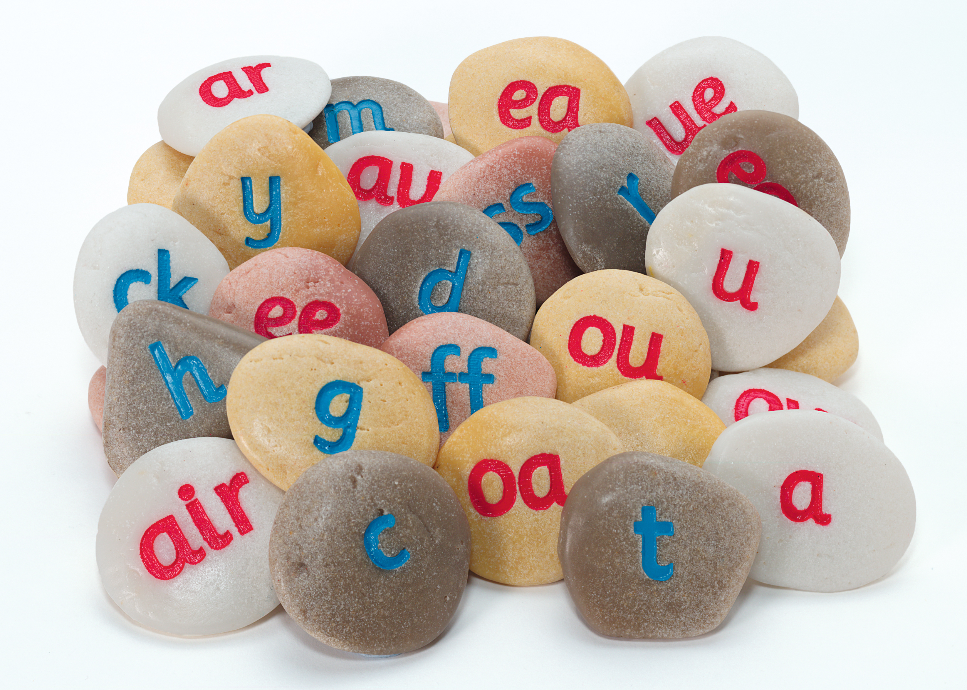
Your handout explains lots more ‘Phonics’ terminology. Please have a read and ask any questions if you are unsure.

Slide 8
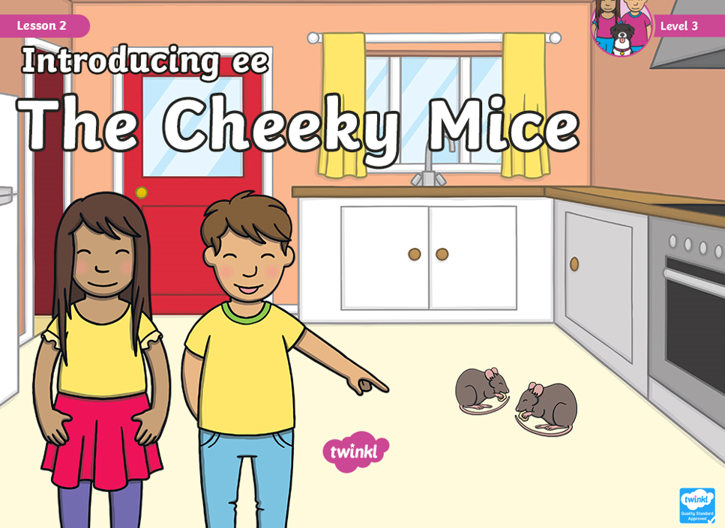
An example of a Phonics lesson.

Slide 9
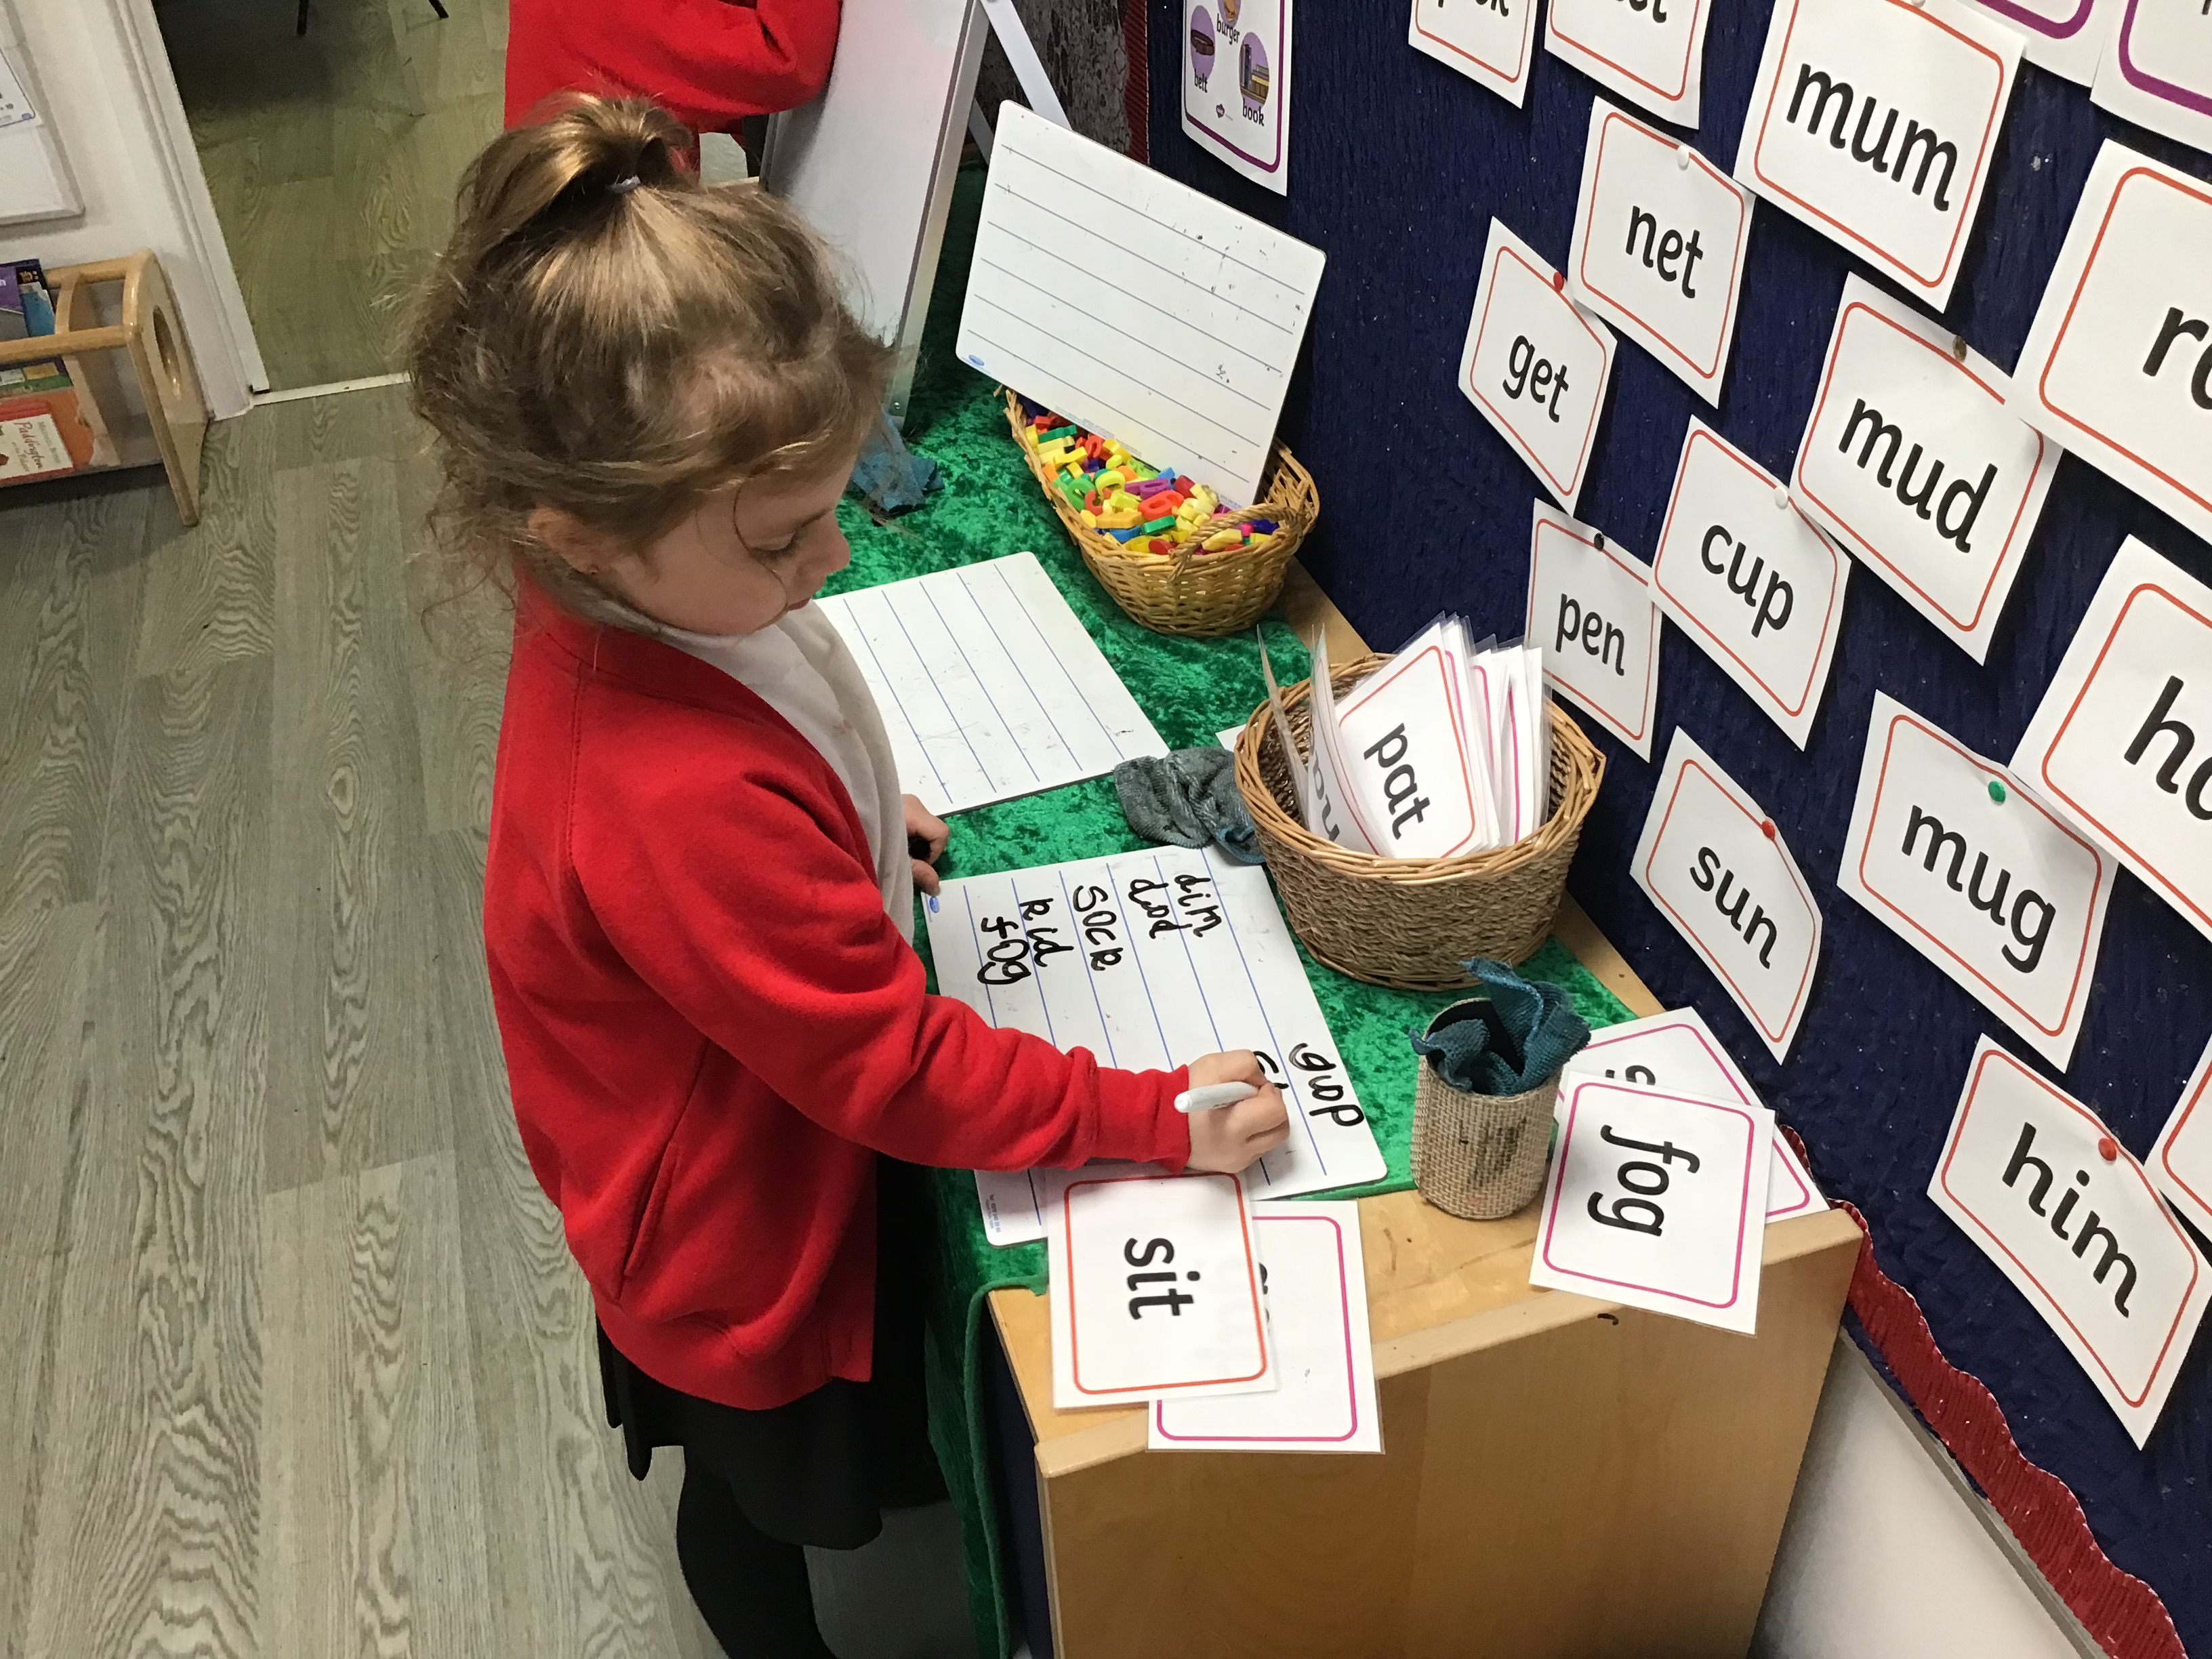
Reading
Tricky Words – Words that we do not sound out, we recognise on sight.
Most focus tricky words in Early Years are for reading, but there are a few in Phase 3 for spelling – I, to, no, go, the.
We will move our learning into Phase 4 looking at adjacent clusters once the children are secure in Phase 3. No new sounds are learnt in Phase 4.
Phase 5 is taught at the start of Year One.
Books – Our reading books, where possible are kept inline with the children’s phonetic understanding. There are many elements to reading a book and not just reading the words. Repetition plays a huge part in young children’s learning and children often really enjoy this too.
Talking about the story – the characters, your favourite part, any new vocabulary heard, predict what might happen next, talk about the illustrations.

Slide 10
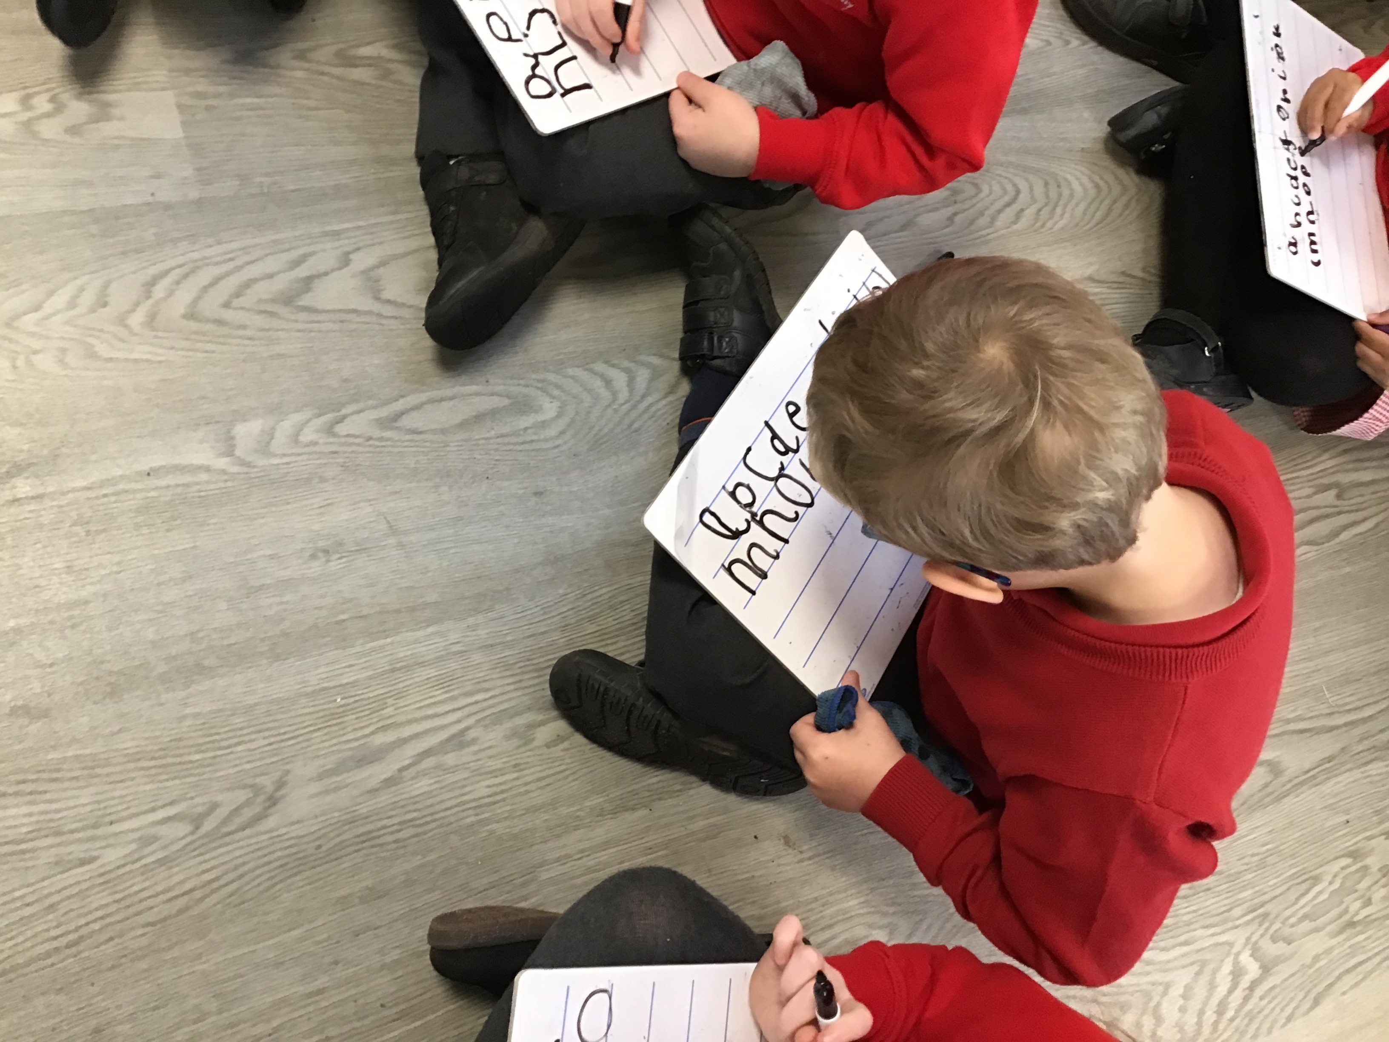
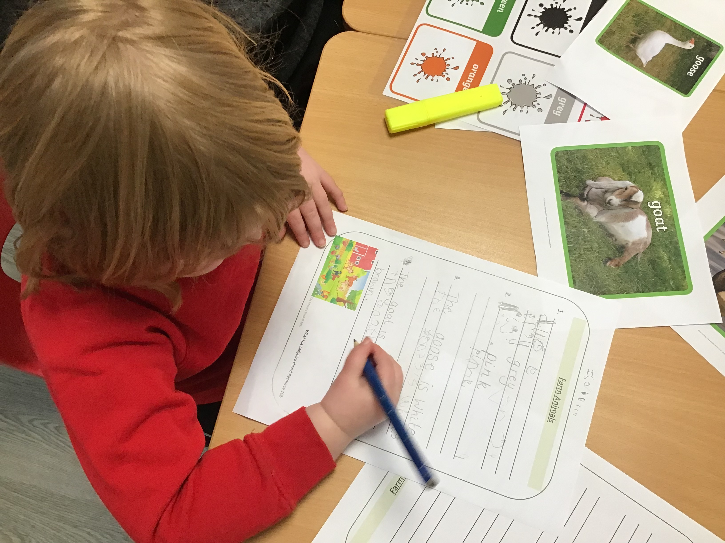
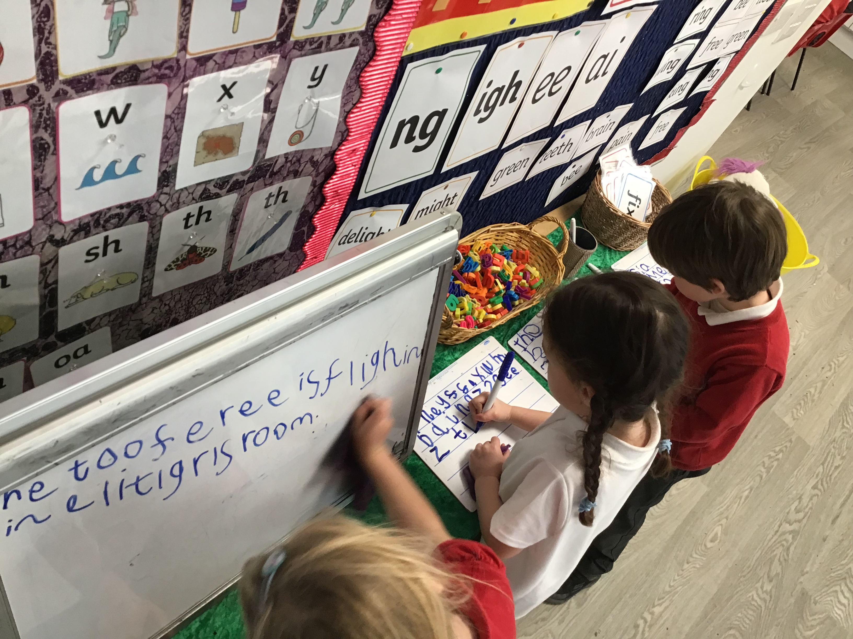
Writing
Writing in the Early Years starts with mark-making.
Funky Fingers – building muscles and strength required for a good pencil grip, good handwriting style and stamina.
Sometimes the children practise their handwriting as a stand-alone lesson, but we also practise writing in Phonics and child-initiated writing opportunities are aplenty during Exploring Time.
The importance of children ‘having a go’ and being confident to sound out words for themselves and write phonetically plausible attempts at words.
Some examples of children’s writing at different stages of development.

Slide 11
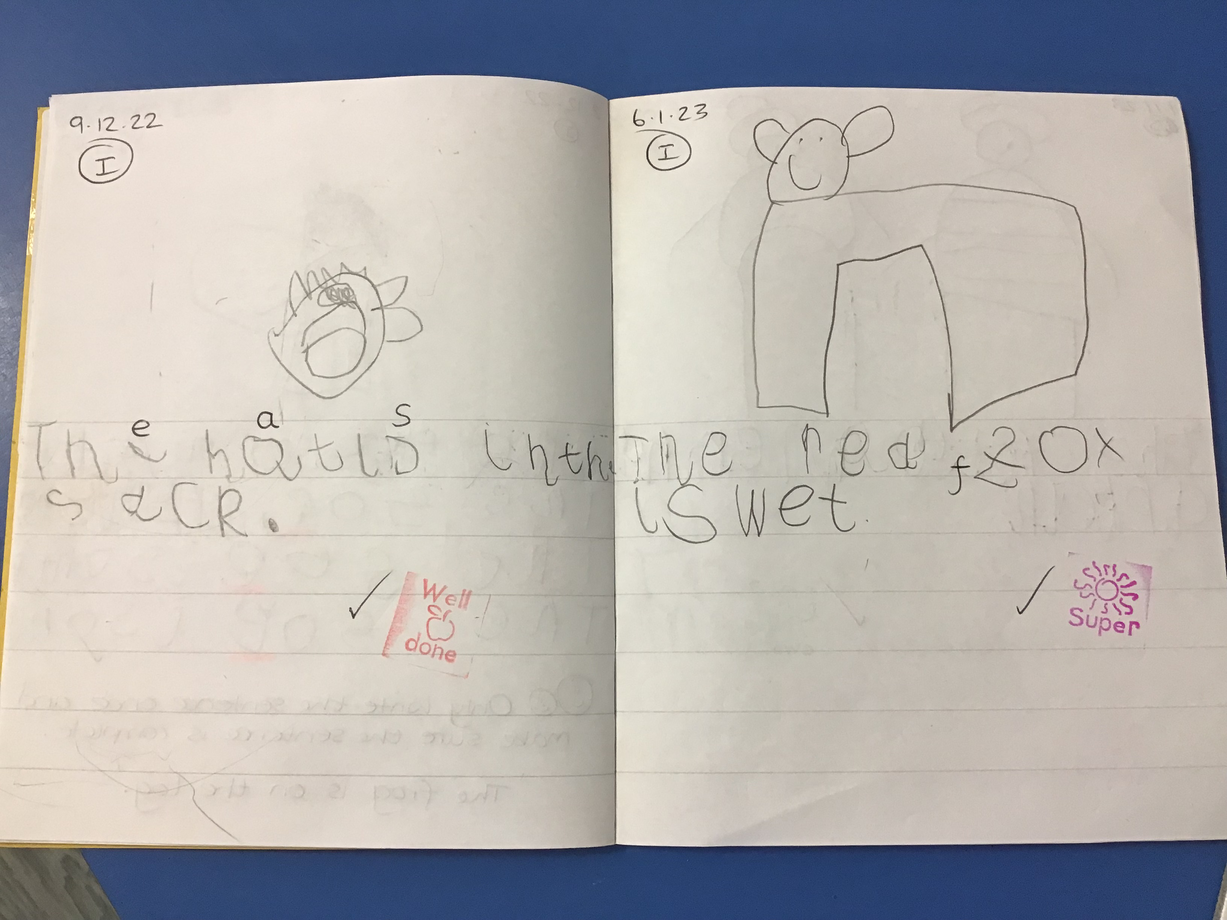
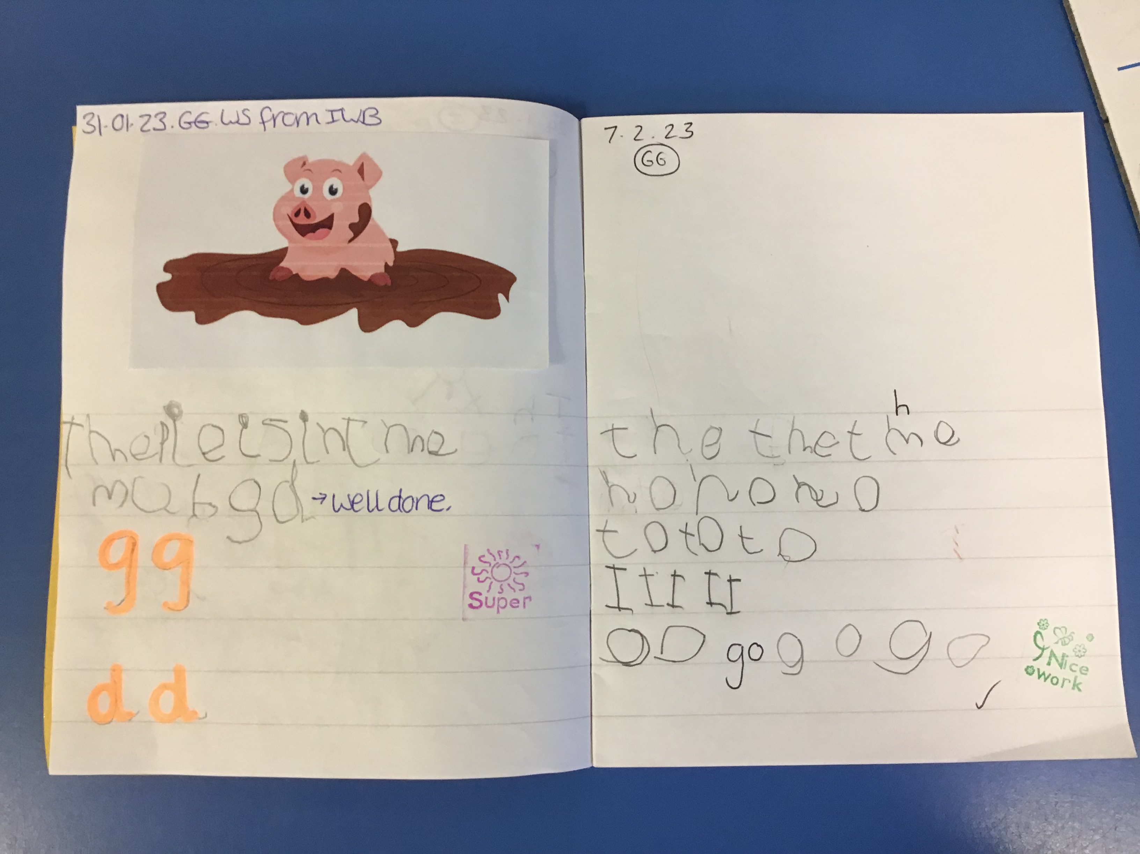
Writing Examples

Slide 12
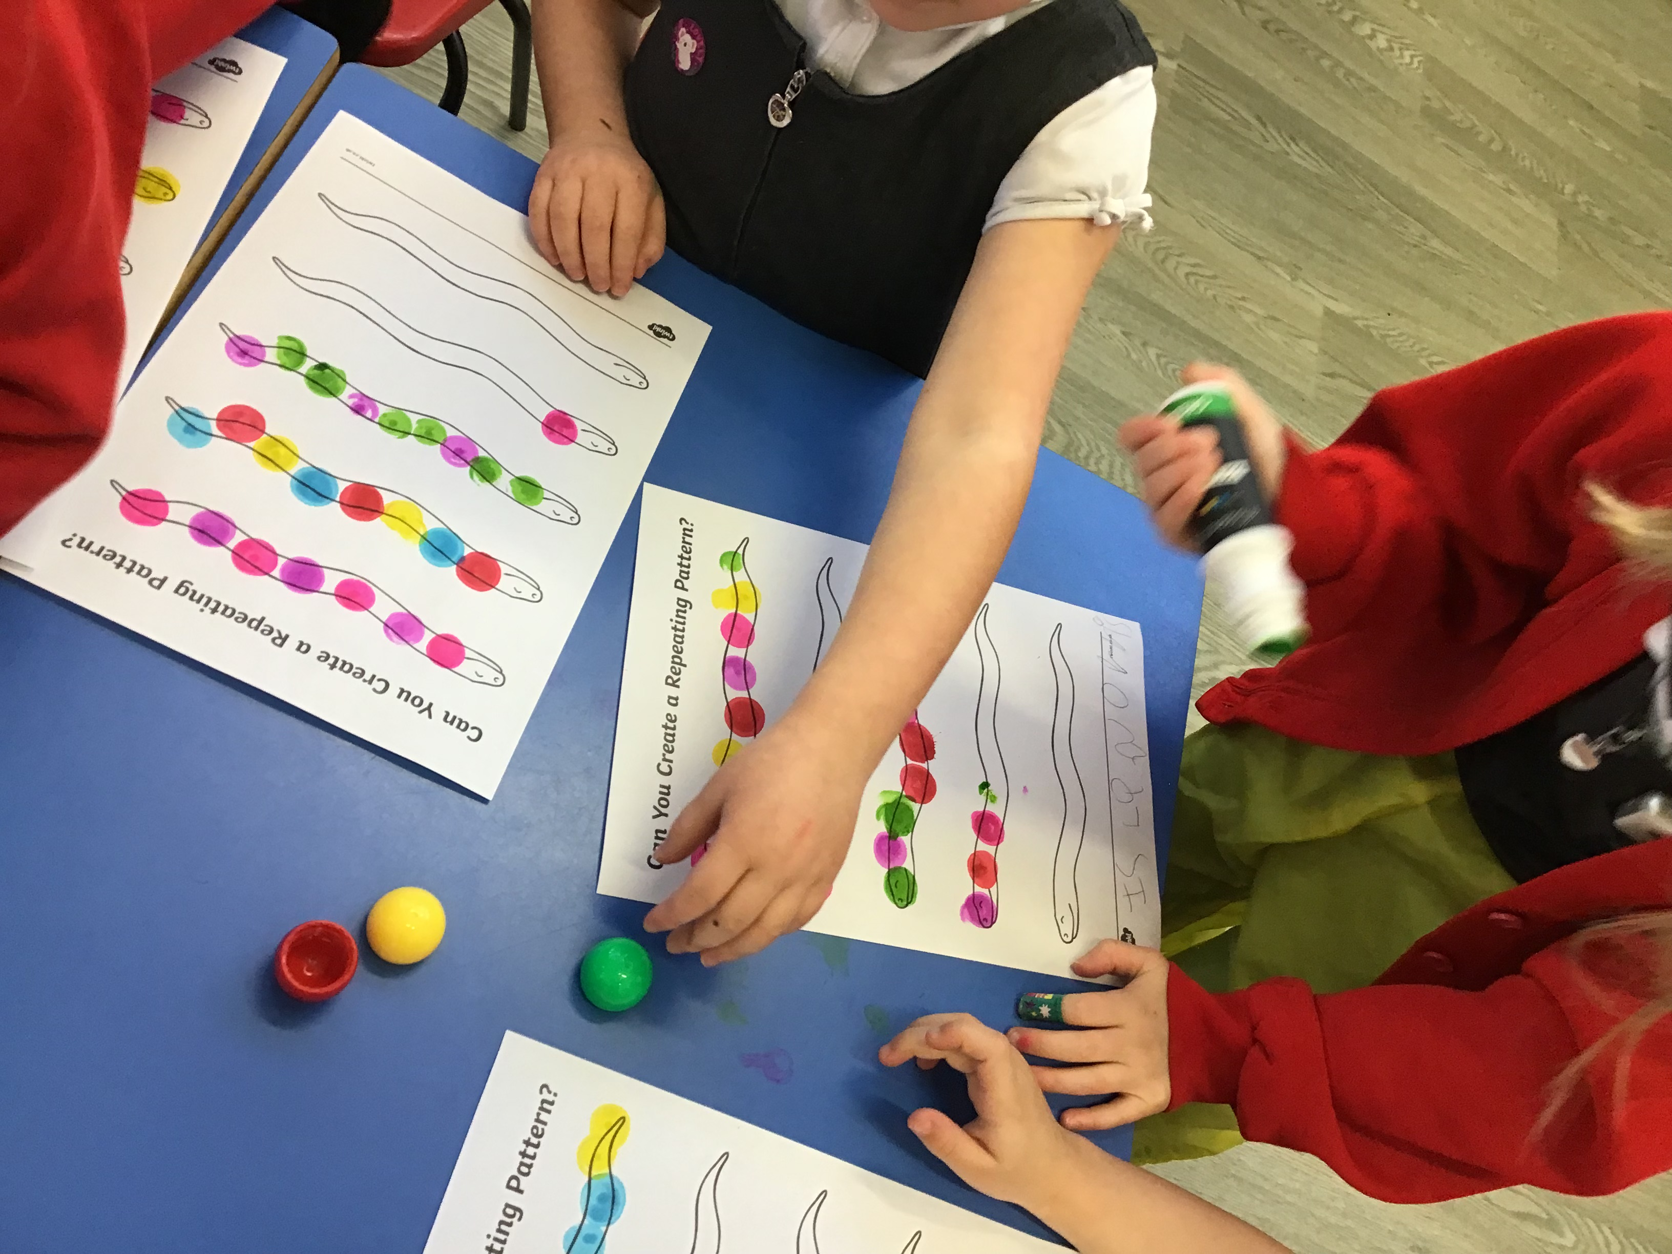
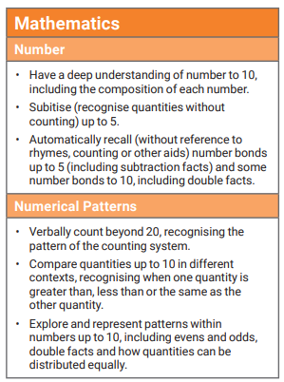
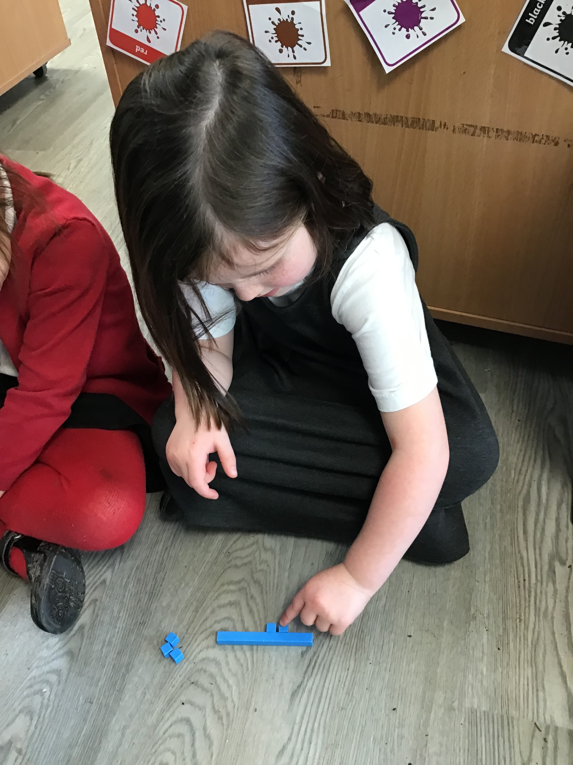
Maths
End of Year expectations –
Heavy focus on number as this is the foundations of all mathematical learning further into KS1.

Slide 13
How can you help your child reach these?
Look at numerals on birthday cards and talk about age. ‘Yesterday you were 3 and now you are 4!’ This can help with recognising and ordering numbers, as well as number formation. You could also encourage your child to draw over the top of the numbers with their finger.
Use mathematical language such as 'You can have one more,' and 'We haven't got any left!' This helps your child learn the concept of ‘how many’.
Similarly, when pouring drinks with your child, use the vocabulary of ‘It’s nearly full, be careful we don’t spill any!’ or ‘Have you drunk it all? Your cup is empty!’
Keeping with the theme of mathematical vocabulary, language related to size is something you probably use often, without realising. Think how many times you have said, 'You're getting really tall!’, ‘These shoes are too small for you now,’ or ‘Your new coat is a bit big, you’ll grow into it!'
Use appropriate words to help your child learn about ordinal numbers, such as 'We'll have our tea first and then we'll go out to play.' When out at the park, riding bikes for example, find those opportunities to comment, ‘Emily was first in the race, Amirah came second!’

Slide 14
How can you help your child reach these?
Add in time language to general conversations with your child, using words such as next, after that, later, soon. For example, ‘You can brush your teeth after your breakfast,’ or ‘We need to go to the shop before we go to school.’ Modelling this vocabulary, and using it regularly will encourage children to naturally use it in their everyday language.
Also include language related to position in your everyday conversations too. If you’re looking for something or encouraging your child to tidy up, ask them 'Is your book under the bed?’ or ‘Have you looked next to the toy box?’
If you enjoy baking with your child, look for those opportunities to talk about what you are doing. For example, when weighing out the ingredients use language such as ‘We need 3 scoops of flour and 2 cups of water.’
On the way up to bed, count the stairs. Sometimes, when children move onto counting objects, they may miss out a number, for example ‘1, 2, 3, 4, 6, 7…’ By counting the stairs regularly, they have a firm understanding of the order of numbers before they transfer this to counting items.

